Slide 1
Fuel Performance
NE 591

Slide 2
Last Time
Developed analytical solutions for temperature profile
This time, we move from the analytical into the numerical framework

Slide 3
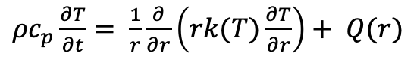

Review of Assumptions
Analytical solution requires:
Steady-state solution
Temperature is axisymmetric
T is constant in Z
Thermal conductivity is independent of temperature
Temperature profile in the fuel is parabolic, linear profiles in gap, clad and coolant
$ρc_{p}\frac{∂T}{∂t}= \frac{1}{r}\frac{∂}{∂r}\left(rk(T)\frac{∂T}{∂r}\right)+ \frac{∂}{∂z}\left(k(T)\frac{∂T}{∂z}\right)+Q(r,z)$
$ρc_{p}\frac{∂T}{∂t}= \frac{1}{r}\frac{∂}{∂r}\left(rk(T)\frac{∂T}{∂r}\right)+ Q(r)$

Slide 4
Solution of Heat Equation
Parabolic profile of temperature in fuel
Cosine profile of LHR as a function of z on fuel rod
The heat equation can be solved using numerical methods
Numerical solution methods are needed for time derivative and gradients.
Time derivative solution methods march through time in steps and can be
Explicit: utilizes current state to make prediction about future state
Implicit: utilizes current state and future state to make prediction about future state

Slide 5
Spatial discretization

Slide 6
Spatial resolution
To numerically solve in space, we need to discretize
Finite difference
convert differential equations into a system of equations that can be solved by matrix algebra techniques
Finite volume
volume integrals in a partial differential equation that contain a divergence term are converted to surface integrals, using the divergence theorem. These terms are then evaluated as fluxes at the surfaces of each finite volume
Finite element
subdivides a large system into smaller, simpler parts that are called finite elements, the equations that model these finite elements are then assembled into a larger system of equations that models the entire problem

Slide 7
Finite Difference
The finite difference method solves on a grid and uses numerical derivatives
Derivatives are approximated by differences
Boundary conditions must have either a fixed T or dT/dr
Typically restricted to handle rectangular shapes
Once you compute the time derivative, you can use either forward or backward Euler to march through time
T(r, t)
T(r + h, t)
T(r – h, t)

Slide 8
Finite Volume
Discretize the domain by subdomains
Domain size h
We place points in the subdomain centers and on either boundary
The finite volume method balances fluxes across the boundaries of your divided subdomains
Integrate our PDE across the subdomain
Evaluate the integral using a linear approximation of the variable
Restricted to flux boundary conditions, often used in flow-type problems

Slide 9
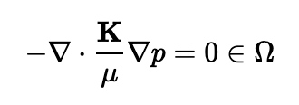
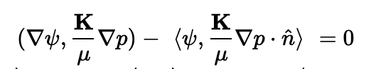
Finite Element
In the finite element method, we interpolate the variable using nodal values and integrate over elements
Systematically recombine all sets of element equations into a global system of equations for the final calculation
Write the strong form of the equation, rearrange to get zero on the right-hand side, multiply by the test function, integrate over the domain, yielding weak form
The strong form states conditions that must be met at every material point, whereas weak form states conditions that must be met only in an average sense
Finite element works for any geometry and any boundary condition
e1
e2
e3
n1 n2 n3 n4

Slide 10
Spatial resolution
Finite difference
Advantages
Simple
Easy to code
Fast
Disadvantages
Difficult to model complex geometries
Difficult to model complex BCs
Only represents solution at points
Difficult to represent heterogeneous properties
Finite Volume
Advantages
Can model any geometry
Naturally conservative
Heterogeneous properties
Disadvantages
Boundary conditions add complexity
More complicated than finite difference
Finite Element
Advantages
Can model any geometry
Can model any BC
Continuous representation
Heterogeneous properties
Disadvantages
Complicated
Somewhat more expensive

Slide 11
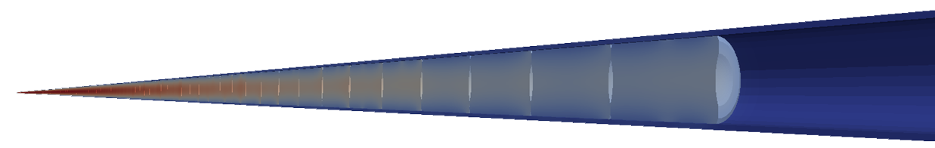


Different Fuel Performance Problems
Transient, full 3D
Transient, 2D axisymmetric with discrete pellets
Computational cost
Transient, 2D axisymmetric with smeared pellets
Accuracy
Transient, multiple 1D slices (1.5D)
Transient, 1D
Steady state, 1D (analytical)

Slide 12
Numerical Approaches to Different Fuel Performance Problems
Transient, full 3D
FEM or FV
Transient, 2D axisymmetric with discrete pellets
FEM or FV
Computational cost
Transient, 2D axisymmetric with smeared pellets
FEM, FV, or FD
Accuracy
Transient, multiple 1D slices (1.5D)
FEM, FV, or FD
Transient, 1D
FEM, FV, or FD
Steady state, 1D (analytical)

Slide 13
Heat equation solution approach summary
Approach | Solution | Assumptions
1D steady state | Analytical | Steady state, axisymmetric, no axial variation, constant k
1D transient | FEM, FD, FV | Axisymmetric, no axial variation
1.5D transient | FEM, FD, FV with multiple slices | Axisymmetric, no axial variation
2D transient, smeared pellets | FEM, FD, FV | Axisymmetric, fuel pellets act as one body, fuel pellets are perfect cylinders
2D transient, discrete pellets | FEM, FV | Axisymmetric
3D transient | FEM, FV | You have a big computer
Each numerical solution can be solved explicitly or implicitly

Slide 14
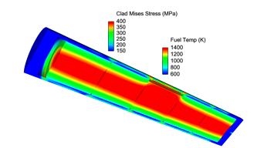
Solving with fuel performance codes
Fuel performance codes primarily use either finite difference or finite element
The earliest fuel performance codes solved the heat equation in 1.5D using finite difference (with multiple axial slices)
More modern codes have switched to finite element, due to more flexibility with geometry and boundary conditions
Finite volume is not used because it can’t solve for the stress

Slide 15
Summary
The heat equation can be solved using numerical methods.
Spatial derivative solution methods divide the domain up into smaller pieces
Finite difference
Finite volume
Finite element
Each discretization has strengths/weaknesses
Finite element is primary method for high fidelity fuel performance codes

Slide 16
Notes
Exam on Feb. 11
Will cover all classes up to and including today
Wellness day next Tuesday, Feb. 9
Will contain both conceptual and work-through problems
Major topics covered:
Fuel types
Heat generation
Reactor Systems
Fuel fabrication
Heat transfer
Analytical solution to heat transfer
Numerical solution to heat transfer
Total of 1.5 hours to complete the exam (class period plus 15 minute buffer)
Will be available for a problem session during office hours next week

